Slide 1
Object-Oriented Programming in C#
Lesson 3
Class, Methods, Constructors
Static Class Members, Designing Objects
Inheritance, Polymorphism

Slide 2
Object-Oriented Programming
OOP is a design philosophy. It stands for Object Oriented Programming.
Object-Oriented Programming (OOP) uses a different set of programming languages than old procedural programming languages (C, Pascal, etc.). Everything in OOP is grouped as self sustainable "objects".
Gain reusability by means of four main object-oriented programming concepts.
C# provides full support for object-oriented programming including encapsulation, inheritance, and polymorphism.

Slide 3
ELI5: Explain Like I'm Five
A program involving animals might have a 'dog' class. The 'dog' class could contain methods for walking, barking, tail-wagging, begging, and sitting. These are things that all dogs can do.
The properties of the dog class could be fur color (all dogs have fur, but each dog can have a unique fur color), size (all dogs have a size, but each dog can have a different size), and 'breed' (all dogs have a breed, but each dog can be a different breed, such as a lab, pit bull, etc).
Rather than write code for each dog to be able to run and bark, you can just create new dogs from your 'dog' class. Your 'run' and 'bark' code is only written once, but every 'dog' object you create from the dog class can use those 'run' and 'bark' functions.

Slide 4
Four Pillars of OOP
Abstraction is a technique for arranging complexity of computer systems. It works by establishing a level of complexity on which a person interacts with the system, suppressing the more complex details below the current level.
Encapsulation means that a group of related properties, methods, and other members are treated as a single unit or object.
Inheritance describes the ability to create new classes based on an existing class.
Polymorphism means that you can have multiple classes that can be used interchangeably, even though each class implements the same properties or methods in different ways.

Slide 5
Object
An object can be considered a "thing" that can perform a set of related activities.
The set of activities that the object performs defines the object's behavior. For example, the Hand (object) can grip something, or a Student (object) can give their name or address.
In pure OOP terms an object is an instance of a class.
In C# everything is an object

Slide 6
Class
A class is simply a representation of a type of object. It is the blueprint, or plan, or template, that describes the details of an object.
A class is the blueprint from which the individual objects are created. Class is composed of three things: a name, attributes, and operations.
In real world, you'll often find many individual objects all of the same kind. As an example, there may be thousands of other bicycles in existence, all of the same make and model.
Each bicycle has built from the same blueprint. In object-oriented terms, we say that the bicycle is an instance of the class of objects known as bicycles.

Slide 7

Classes and Objects
The terms class and object are sometimes used interchangeably, but in fact, classes describe the type of objects, while objects are usable instancesof classes.
So, the act of creating an object is called instantiation. Using the blueprint analogy, a class is a blueprint, and an object is a building made from that blueprint.
To define a class:

Slide 8
Class Members
Each class can have different class members that include properties that describe class data, methods that define class behavior, and events that provide communication between different classes and objects.
Properties and Fields
Methods
Constructors
Finalizers
Events
Nested Classes

Slide 9

Properties and Fields
Fields and properties represent information that an object contains. Fields are like variables because they can be read or set directly.
To define a field:

Slide 10

Properties and Fields
Properties have get and set procedures, which provide more control on how values are set or returned.
C# allows you either to create a private field for storing the property value or use so-called auto-implemented properties that create this field automatically behind the scenes and provide the basic logic for the property procedures.1
To define an auto-implemented property:

Slide 11
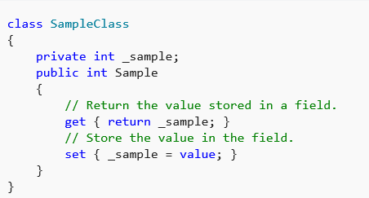
Properties and Fields
If you need to perform some additional operations for reading and writing the property value, define a field for storing the property value and provide the basic logic for storing and retrieving it:

Slide 12
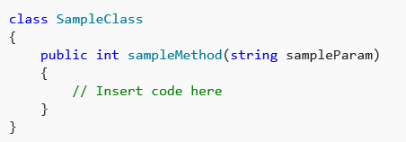
Methods
A method is an action that an object can perform.
To define a method of a class:

Slide 13

Methods
A class can have several implementations, or overloads, of the same method that differ in the number of parameters or parameter types. +
To overload a method:
C# also supports extension methods that allow you to add methods to an existing class outside the actual definition of the class.

Slide 14
Constructors
Constructors are class methods that are executed automatically when an object of a given type is created.
Constructors usually initialize the data members of the new object.
A constructor can run only once when a class is created.
Constructor always runs before any other code in a class.
You can create multiple constructor overloads in the same way as for any other method.

Slide 15
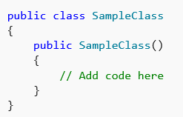
Constructors
To define a constructor for a class:

Slide 16
Finalizers
Finalizers are used to destruct instances of classes.
In the .NET Framework, the garbage collector automatically manages the allocation and release of memory for the managed objects in your application.
You may still need finalizers to clean up any unmanaged resources that your application creates.
There can be only one finalizers for a class.

Slide 17
Events
Events enable a class or object to notify other classes or objects when something of interest occurs.
The class that sends (or raises) the event is called the publisher and the classes that receive (or handle) the event are called subscribers.
To declare an event in a class, use the event keyword.
To raise an event, invoke the event delegate.
To subscribe to an event, use the += operator; to unsubscribe from an event, use the -= operator.

Slide 18
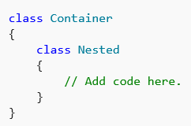
Nested Classes
A class defined within another class is called nested. By default, the nested class is private.
To create an instance of the nested class, use the name of the container class followed by the dot and then followed by the name of the nested class:

Slide 19
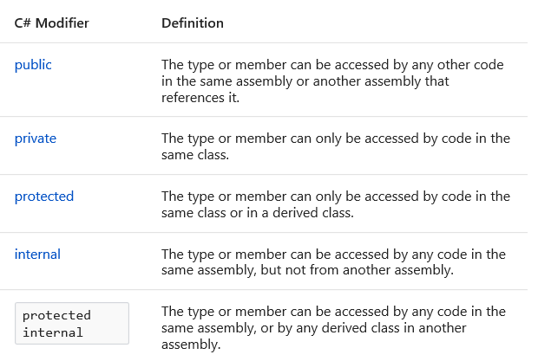
Access Modifiers and Access Levels
All classes and class members can specify what access level they provide to other classes by using access modifiers.
The following access modifiers are available:

Slide 20

Instantiating Classes
To create an object, you need to instantiate a class, or create a class instance.
After instantiating a class, you can assign values to the instance's properties and fields and invoke class methods.

Slide 21

Instantiating Classes
To assign values to properties during the class instantiation process, use object initializers:

Slide 22

Static Classes and Members
A static member of the class is a property, procedure, or field that is shared by all instances of a class.
To define a static member:

Slide 23
Static Classes and Members
To access the static member, use the name of the class without creating an object of this class:
Static classes in C# have static members only and cannot be instantiated. Static members also cannot access non-static properties, fields or methods

Slide 24

Anonymous Types
Anonymous types enable you to create objects without writing a class definition for the data type.
Instead, the compiler generates a class for you. The class has no usable name and contains the properties you specify in declaring the object.
To create an instance of an anonymous type:

Slide 25

Inheritance
Inheritance enables you to create a new class that reuses, extends, and modifies the behavior that is defined in another class.
The class whose members are inherited is called the base class, and the class that inherits those members is called the derived class.
All classes in C# implicitly inherit from the Object class that supports .NET class hierarchy and provides low-level services to all classes.
To inherit from a base class:

Slide 26
Inheritance
Conceptually, a derived class is a specialization of the base class.
For example, if you have a base class Animal, you might have one derived class that is named Mammal and another derived class that is named Reptile. A Mammal is an Animal, and a Reptile is an Animal, but each derived class represents different specializations of the base class.

Slide 27
Inheritance
When you define a class to derive from another class, the derived class implicitly gains all the members of the base class, except for its constructors and finalizers.
The derived class can thereby reuse the code in the base class without having to re-implement it. In the derived class, you can add more members. In this manner, the derived class extends the functionality of the base class.

Slide 28
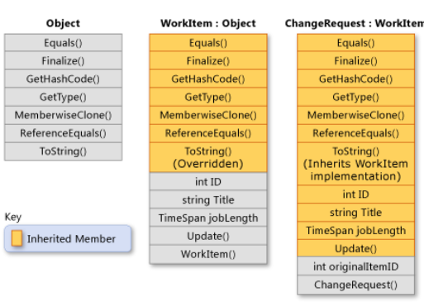
Inheritance
The following illustration shows a class WorkItem that represents an item of work in some business process. Like all classes, it derives from System.Object and inherits all its methods. WorkItem adds five members of its own.

Slide 29


Inheritance
By default all classes can be inherited. However, you can specify whether a class must not be used as a base class, or create a class that can be used as a base class only.
To specify that a class cannot be used as a base class:
To specify that a class can be used as a base class only and cannot be instantiated:

Slide 30
Abstract and Virtual Methods
When a base class declares a method as virtual, a derived class can override the method with its own implementation.
If a base class declares a member as abstract, that method must be overridden in any non-abstract class that directly inherits from that class.
If a derived class is itself abstract, it inherits abstract members without implementing them.
Abstract and virtual members are the basis for polymorphism, which is the second primary characteristic of object-oriented programming.

Slide 31
Abstract Base Classes
You can declare a class as abstract if you want to prevent direct instantiation by using the new keyword. If you do this, the class can be used only if a new class is derived from it.
An abstract class can contain one or more method signatures that themselves are declared as abstract.
These signatures specify the parameters and return value but have no implementation (method body).

Slide 32
Abstract Base Classes
An abstract class does not have to contain abstract members; however, if a class does contain an abstract member, the class itself must be declared as abstract.
Derived classes that are not abstract themselves must provide the implementation for any abstract methods from an abstract base class.

Slide 33
Abstract Base Classes
In this example, the class Square must provide an implementation of Area because it derives from ShapesClass:
https://docs.microsoft.com/en-us/dotnet/csharp/language-reference/keywords/abstract

Slide 34
Abstract Base Classes
Abstract classes have the following features:
An abstract class cannot be instantiated.
An abstract class may contain abstract methods and accessors.
It is not possible to modify an abstract class with the sealed modifier because the two modifers have opposite meanings. The sealed modifier prevents a class from being inherited and the abstract modifier requires a class to be inherited.
A non-abstract class derived from an abstract class must include actual implementations of all inherited abstract methods and accessors

Slide 35
Abstract Base Classes
Use the abstract modifier in a method or property declaration to indicate that the method or property does not contain implementation.
Abstract methods have the following features:
An abstract method is implicitly a virtual method.
Abstract method declarations are only permitted in abstract classes.
Because an abstract method declaration provides no actual implementation, there is no method body; the method declaration simply ends with a semicolon and there are no curly braces ({ }) following the signature.
It is an error to use the static or virtual modifiers in an abstract method declaration.

Slide 36
Abstract Base Classes
Abstract properties behave like abstract methods, except for the differences in declaration and invocation syntax.
It is an error to use the abstract modifier on a static property.
An abstract inherited property can be overridden in a derived class by including a property declaration that uses the override modifier.

Slide 37
Overriding Members
By default, a derived class inherits all members from its base class.
If you want to change the behavior of the inherited member, you need to override it.
You can define a new implementation of the method, property or event in the derived class.

Slide 38
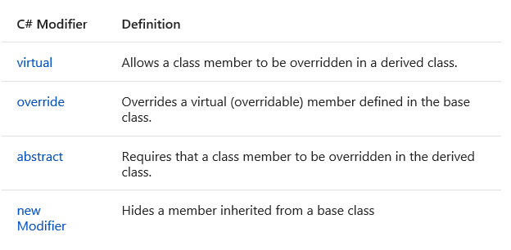
Overriding Members
The following modifiers are used to control how properties and methods are overridden:

Slide 39
Polymorphism
Polymorphism is a feature that allows one interface to be used for a general class of action. This concept is often expressed as "one interface, multiple actions". The specific action is determined by the exact nature of circumstances.

Slide 40
Polymorphism
Polymorphism is a Greek word that means "many-shaped" and it has two distinct aspects:
At run time, objects of a derived class may be treated as objects of a base class in places such as method parameters and collections or arrays. When this occurs, the object's declared type is no longer identical to its run-time type.
Base classes may define and implement virtual methods, and derived classes can override them, which means they provide their own definition and implementation.

Slide 41
Polymorphism
Example: https://docs.microsoft.com/en-us/dotnet/csharp/programming-guide/classes-and-structs/polymorphism

Slide 42
Virtual Members
When a derived class inherits from a base class, it gains all the methods, fields, properties and events of the base class. The designer of the derived class can choose whether to
override virtual members in the base class,
inherit the closest base class method without overriding it
define new non-virtual implementation of those members that hide the base class implementations

Slide 43
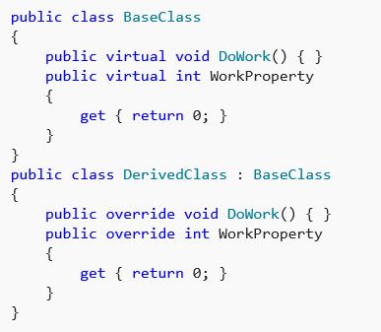
Virtual Members

Slide 44
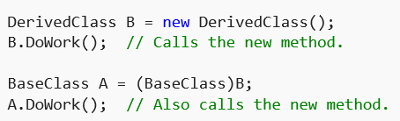
Virtual Members
Fields cannot be virtual; only methods, properties, events and indexers can be virtual.
When a derived class overrides a virtual member, that member is called even when an instance of that class is being accessed as an instance of the base class.
The following code provides an example:

Slide 45
Hiding Base Class Members
If you want your derived member to have the same name as a member in a base class, but you do not want it to participate in virtual invocation, you can use the new keyword.
The new keyword is put before the return type of a class member that is being replaced. The following code provides an example:

Slide 46
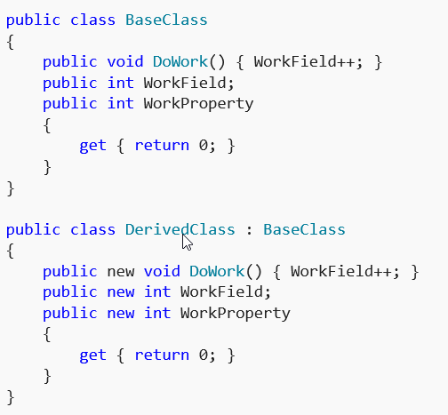
Hiding Base Class Members

Slide 47
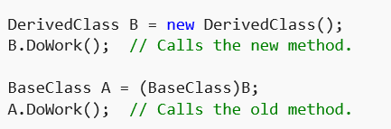
Hiding Base Class Members
Hidden base class members can still be accessed from client code by casting the instance of the derived class to an instance of the base class. For example:

Slide 48
Preventing Derived Classes from Overriding Virtual Members
Virtual members remain virtual indefinitely, regardless of how many classes have been declared between the virtual member and the class that originally declared it.
If class A declares a virtual member, and class B derives from A, and class C derives from B, class C inherits the virtual member, and has the option to override it, regardless of whether class B declared an override for that member.

Slide 49
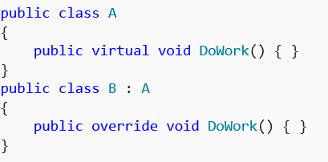
Preventing Derived Classes from Overriding Virtual Members
The following code provides an example:

Slide 50
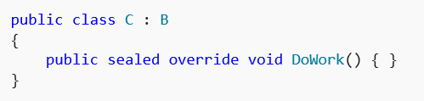
Preventing Derived Classes from Overriding Virtual Members
A derived class can stop virtual inheritance by declaring an override as sealed. This requires putting the sealed keyword before the override keyword in the class member declaration. The following code provides an example:

Slide 51
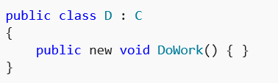
Preventing Derived Classes from Overriding Virtual Members
In the previous example, the method DoWork is no longer virtual to any class derived from C. It is still virtual for instances of C, even if they are cast to type B or type A. Sealed methods can be replaced by derived classes by using the new keyword, as the following example shows:

Slide 52
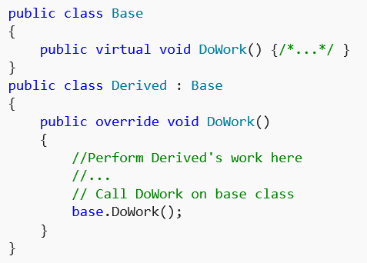
Accessing Base Class Virtual Members from Derived Classes
A derived class that has replaced or overridden a method or property can still access the method or property on the base class using the base keyword. The following code provides an example:

Slide 53
Designing Objects
Design Patterns
http://www.dofactory.com/net/design-patterns
SOLID

Slide 54
SOLID
S.O.L.I.D is an acronym for the first five object-oriented design(OOD) principles by Robert C. Martin, popularly known as Uncle Bob.
These principles, when combined together, make it easy for a programmer to develop software that are easy to maintain and extend.
They also make it easy for developers to avoid code smells, easily refactor code, and are also a part of the agile or adaptive software development

Slide 55
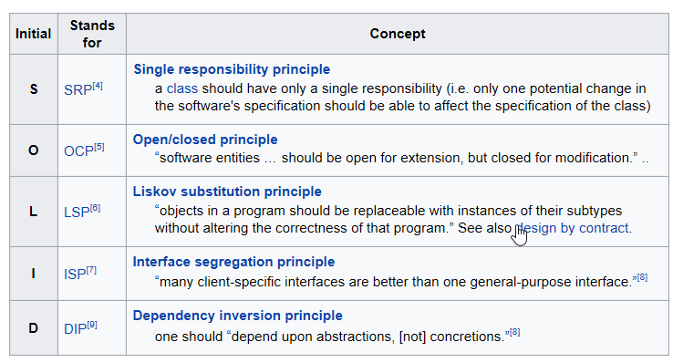
SOLID
S.O.L.I.D stands for:

Slide 56
Programming with C#
Lesson 4
Arrays, Collections
Interfaces
Exception Handlings
Delegates and Events

Slide 57
Arrays
You can store multiple variables of the same type in an array data structure. You declare an array by specifying the type of its elements.
An array can be Single-Dimensional, Multidimensional or Jagged.
The number of dimensions and the length of each dimension are established when the array instance is created. These values can't be changed during the lifetime of the instance.
Notes:
The predefined reference types are object and string. The type object is the ultimate base type of all other types. The type string is used to represent Unicode string values. Values of type string are immutable.
The predefined value types include signed and unsigned integral types, floating point types, and the types bool, char, and decimal. The signed integral types are sbyte, short, int, and long; the unsigned integral types are byte, ushort, uint, and ulong; and the floating point types are floatand double.
The bool type is used to represent Boolean values: values that are either true or false. The inclusion of bool makes it easier to write self-documenting code, and also helps eliminate the all-too-common C++ coding error in which a developer mistakenly uses "=" when "==" should have been used. In C#, the example
Common examples include financial calculations such as tax computations and currency conversions. The decimal type provides 28 significant digits.

Slide 58
Arrays
The default values of numeric array elements are set to zero, and reference elements are set to null.
A jagged array is an array of arrays, and therefore its elements are reference types and are initialized to null.
Arrays are zero indexed: an array with n elements is indexed from 0 to n-1.

Slide 59
Arrays
Array elements can be of any type, including an array type.
Array types are reference types derived from the abstract base type Array. Since this type implements IEnumerable and IEnumerable<T>, you can use foreach iteration on all arrays in C#.

Slide 60



Single-Dimensional Arrays
You can declare a single-dimensional array of five integers as shown in the following example:
Array Initialization:

Slide 61


Multidimensional Arrays
Arrays can have more than one dimension. For example, the following declaration creates a two-dimensional array of four rows and two columns.

Slide 62
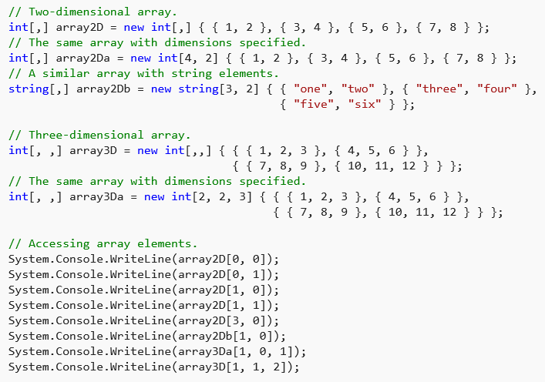
Multidimensional Arrays
You can initialize the array upon declaration, as is shown in the following example.

Slide 63

Jagged Arrays
A jagged array is an array whose elements are arrays. The elements of a jagged array can be of different dimensions and sizes.
A jagged array is sometimes called an "array of arrays.“
The following is a declaration of a single-dimensional array that has three elements, each of which is a single-dimensional array of integers:

Slide 64


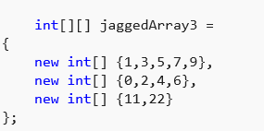
Jagged Arrays
Before you can use jaggedArray, its elements must be initialized. You can initialize the elements like this:

Slide 65
Jagged Arrays
Before you can use jaggedArray, its elements must be initialized. You can initialize the elements like this:

Slide 66
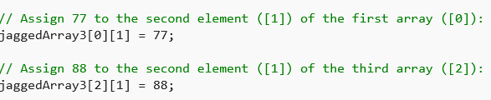
Jagged Arrays
A jagged array is an array of arrays, and therefore its elements are reference types and are initialized to null. +
You can access individual array elements like these examples

Slide 67
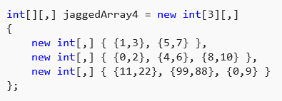
Jagged and Multidimension Arrays
It is possible to mix jagged and multidimensional arrays.
The following is a declaration and initialization of a single-dimensional jagged array that contains three two-dimensional array elements of different sizes.

Slide 68
Collections
Collections provide a more flexible way to work with groups of objects. Unlike arrays, the group of objects you work with can grow and shrink dynamically as the needs of the application change.
For some collections, you can assign a key to any object that you put into the collection so that you can quickly retrieve the object by using the key.
A collection is a class, so you must declare an instance of the class before you can add elements to that collection.

Slide 69
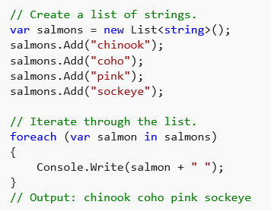
Using a Simple Collection
The examples in this section use the generic List<T> class, which enables you to work with a strongly typed list of objects. +
The following example creates a list of strings and then iterates through the strings by using a or foreach statement.

Slide 70
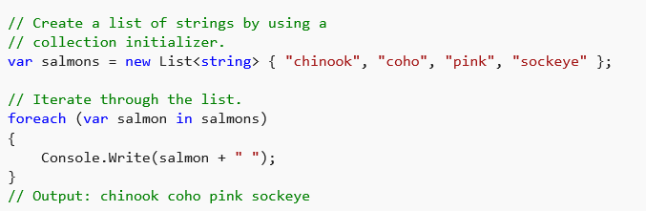
Using a Simple Collection
If the contents of a collection are known in advance, you can use a collection initializer to initialize the collection. For more information, see Object and Collection Initializers.
The following example is the same as the previous example, except a collection initializer is used to add elements to the collection.

Slide 71
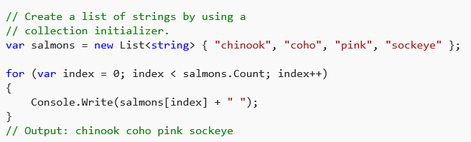
Using a Simple Collection
You can use a for statement instead of a foreach statement to iterate through a collection.
You accomplish this by accessing the collection elements by the index position. The index of the elements starts at 0 and ends at the element count minus 1.

Slide 72
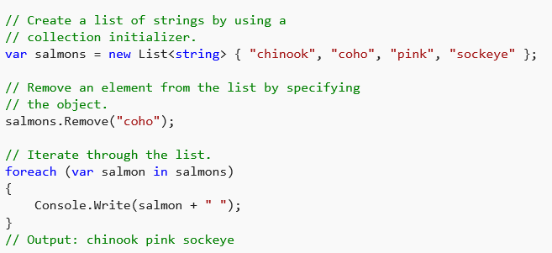
Using a Simple Collection
The following example removes an element from the collection by specifying the object to remove.

Slide 73
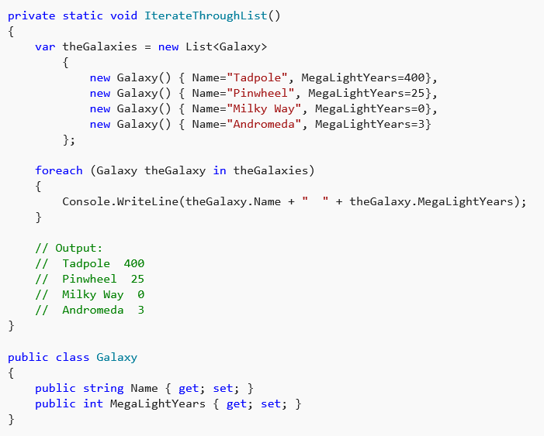
Using a Simple Collection
For the type of elements in the List<T>, you can also define your own class. In the following example, the Galaxy class that is used by the List<T> is defined in the code.

Slide 74
Kinds of Collections
Many common collections are provided by the .NET Framework. Each type of collection is designed for a specific purpose. +
Some of the common collection classes are described in this section: +
System.Collections.Generic classes
System.Collections.Concurrent classes
System.Collections classes

Slide 75
System.Collections.Generic Classes
You can create a generic collection by using one of the classes in the System.Collections.Generic namespace. A generic collection is useful when every item in the collection has the same data type. A generic collection enforces strong typing by allowing only the desired data type to be added. +
The following table lists some of the frequently used classes of the System.Collections.Generic namespace:

Slide 76
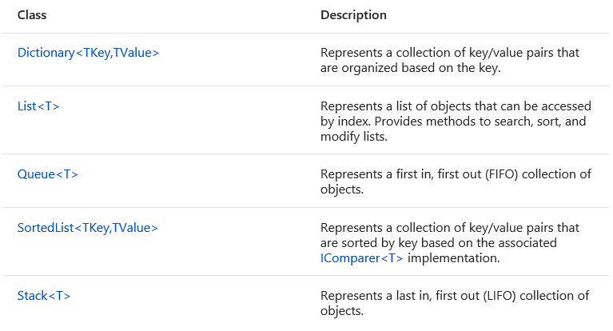
System.Collections.Generic Classes

Slide 77
System.Collections.Concurrent Classes
In the .NET Framework 4 or newer, the collections in the System.Collections.Concurrent namespace provide efficient thread-safe operations for accessing collection items from multiple threads. +
The classes in the System.Collections.Concurrent namespace should be used instead of the corresponding types in the System.Collections.Generic and System.Collections namespaces whenever multiple threads are accessing the collection concurrently.
Some classes included in the System.Collections.Concurrent namespace are BlockingCollection<T>, ConcurrentDictionary<TKey,TValue>, ConcurrentQueue<T>, and ConcurrentStack<T>.

Slide 78
System.Collections Classes
The classes in the System.Collections namespace do not store elements as specifically typed objects, but as objects of type Object. +
Whenever possible, you should use the generic collections in the System.Collections.Generic namespace or the System.Collections.Concurrent namespace instead of the legacy types in the System.Collections namespace.
The following table lists some of the frequently used classes in the System.Collections namespace:

Slide 79
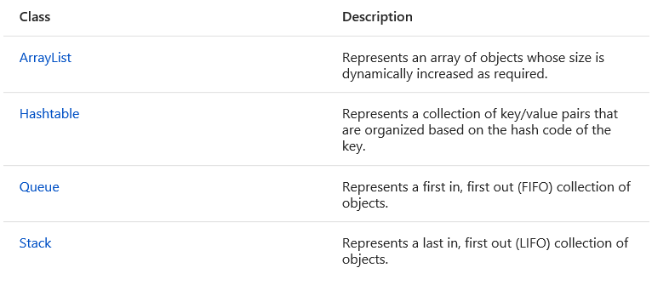
System.Collections Classes

Slide 80
Using LINQ to Access a Collection
LINQ (Language-Integrated Query) can be used to access collections. LINQ queries provide filtering, ordering, and grouping capabilities.
The following example runs a LINQ query against a generic List. The LINQ query returns a different collection that contains the results.

Slide 81
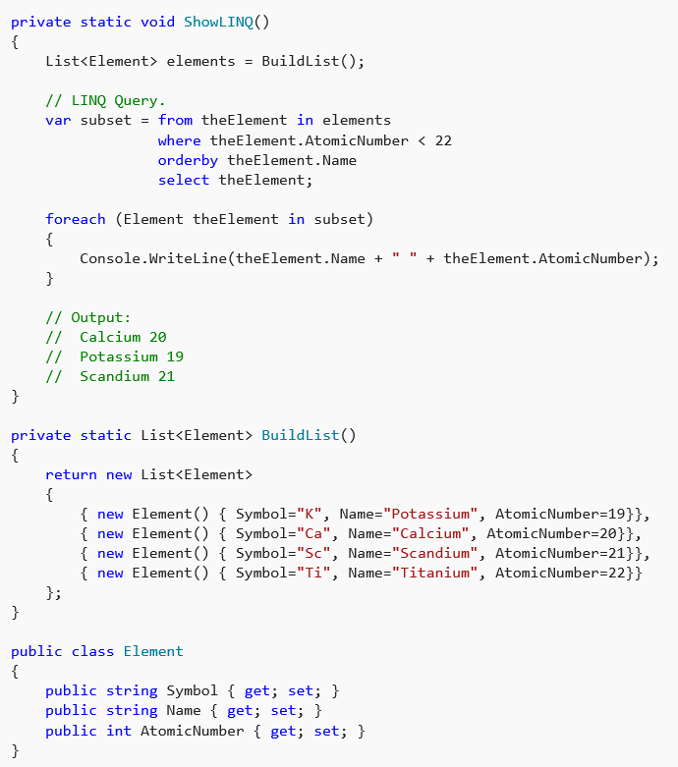
Using LINQ to Access a Collection

Slide 82
interface
An interface contains only the signatures of methods, properties, events or indexers.
A class or struct that implements the interface must implement the members of the interface that are specified in the interface definition.

Slide 83
interface
In the following example, class ImplementationClass must implement a method named SampleMethod that has no parameters and returns void.

Slide 84
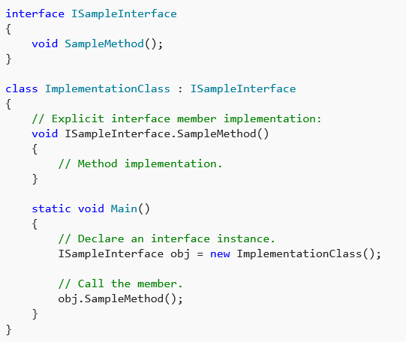
interface

Slide 85
interface
An interface can be a member of a namespace or a class and can contain signatures of the following members:
Methods
Properties
Indexers
Events

Slide 86
Exception Handling
A try block is used by C# programmers to partition code that might be affected by an exception. Associated catch blocks are used to handle any resulting exceptions. A finally block contains code that is run regardless of whether or not an exception is thrown in the try block, such as releasing resources that are allocated in the try block. A try block requires one or more associated catch blocks, or a finally block, or both. +
The following examples show a try-catch statement, a try-finally statement, and a try-catch-finally statement.

Slide 87
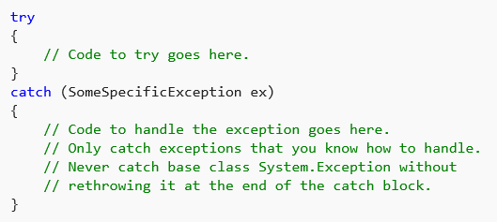
Exception Handling

Slide 88
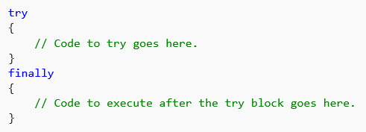
Exception Handling

Slide 89
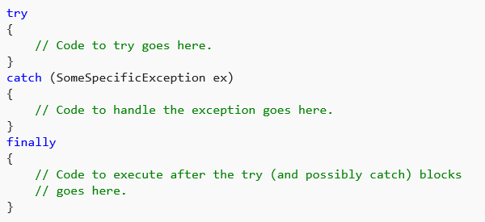
Exception Handling

Slide 90
Catch Blocks
A catch block can specify the type of exception to catch. The type specification is called an exception filter. The exception type should be derived from Exception.
In general, do not specify Exception as the exception filter unless either you know how to handle all exceptions that might be thrown in the try block, or you have included a throw statement at the end of your catch block.

Slide 91
Catch Blocks
Multiple catch blocks with different exception filters can be chained together. The catch blocks are evaluated from top to bottom in your code, but only one catch block is executed for each exception that is thrown.
The first catch block that specifies the exact type or a base class of the thrown exception is executed.
If no catch block specifies a matching exception filter, a catch block that does not have a filter is selected, if one is present in the statement. It is important to position catch blocks with the most specific (that is, the most derived) exception types first.

Slide 92
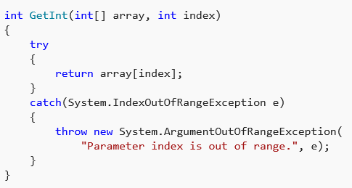
Catch Blocks

Slide 93
Finally Blocks
A finally block enables you to clean up actions that are performed in a try block.
If present, the finally block executes last, after the try block and any matched catch block.
A finally block always runs, regardless of whether an exception is thrown or a catch block matching the exception type is found.
The finally block can be used to release resources such as file streams, database connections, and graphics handles without waiting for the garbage collector in the runtime to finalize the objects.

Slide 94
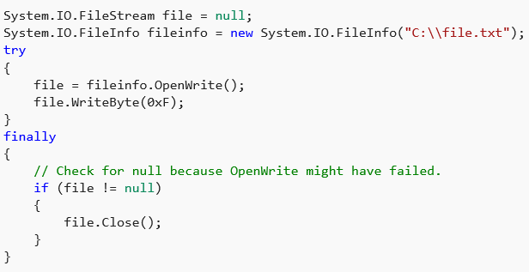
Finally Blocks

Slide 95
Delegates
A delegate is a type that represents references to methods with a particular parameter list and return type.
When you instantiate a delegate, you can associate its instance with any method with a compatible signature and return type.
You can invoke (or call) the method through the delegate instance.

Slide 96
Delegates
Delegates are used to pass methods as arguments to other methods. Event handlers are nothing more than methods that are invoked through delegates.
You create a custom method, and a class such as a windows control can call your method when a certain event occurs. The following example shows a delegate declaration:.

Slide 97
Delegates
Any method from any accessible class or struct that matches the delegate type can be assigned to the delegate.
The method can be either static or an instance method.
This makes it possible to programmatically change method calls, and also plug new code into existing classes.

Slide 98
Delegates
This ability to refer to a method as a parameter makes delegates ideal for defining callback methods.
For example, a reference to a method that compares two objects could be passed as an argument to a sort algorithm. Because the comparison code is in a separate procedure, the sort algorithm can be written in a more general way.

Slide 99
Delegates
Delegates have the following properties:
Delegates are like C++ function pointers but are type safe.
Delegates allow methods to be passed as parameters.
Delegates can be used to define callback methods.
Delegates can be chained together; for example, multiple methods can be called on a single event.
Methods do not have to match the delegate type exactly. For more information, see Using Variance in Delegates.
C# version 2.0 introduced the concept of Anonymous Methods, which allow code blocks to be passed as parameters in place of a separately defined method. C# 3.0 introduced lambda expressions as a more concise way of writing inline code blocks. Both anonymous methods and lambda expressions (in certain contexts) are compiled to delegate types. Together, these features are now known as anonymous functions. For more information about lambda expressions, see Anonymous Functions.

Slide 100
Events
Events enable a class or object to notify other classes or objects when something of interest occurs.
The class that sends (or raises) the event is called the publisher and the classes that receive (or handle) the event are called subscribers.
In a typical C# Windows Forms or Web application, you subscribe to events raised by controls such as buttons and list boxes.

Slide 101
Events
Events have the following properties:
The publisher determines when an event is raised; the subscribers determine what action is taken in response to the event.
An event can have multiple subscribers. A subscriber can handle multiple events from multiple publishers.
Events that have no subscribers are never raised.

Slide 102
Events
Events have the following properties:
Events are typically used to signal user actions such as button clicks or menu selections in graphical user interfaces.
When an event has multiple subscribers, the event handlers are invoked synchronously when an event is raised. To invoke events asynchronously, see Calling Synchronous Methods Asynchronously.
In the .NET Framework class library, events are based on the EventHandler delegate and the EventArgs base class.

Slide 103


Subscribe to and Unsubscribe from Events

Slide 104
Publish Events that Conform to .NET Framework Guidelines
https://docs.microsoft.com/en-us/dotnet/csharp/programming-guide/events/how-to-publish-events-that-conform-to-net-framework-guidelines

